Slide 1

Getting started with MonoGame using Visual Studio for Mac
Darkside of Monogame
Simon Jackson
Author and Microsoft MVP
@SimonDarksidej

Slide 2
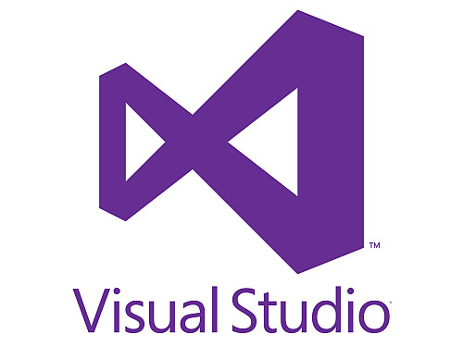
Headline Information
MonoGame 3.8 is about to release
.NETCore and .NetStandard support
New .NetCore tools delivery
No MSI!!
Visual Studio for Mac is the new preferred method for Mac development (Xamarin Studio on Steroids)

Slide 3
Getting Started – Visual Studio for Mac
Session will cover what is needed for:
Developing games for Windows desktop / Linux / OpenGL
Building Content Pipeline Projects
Developing Games for Android
Developing Games for iOS
Developing Games for MacOS
*Windows 10 UWP not supported on Mac

Slide 4
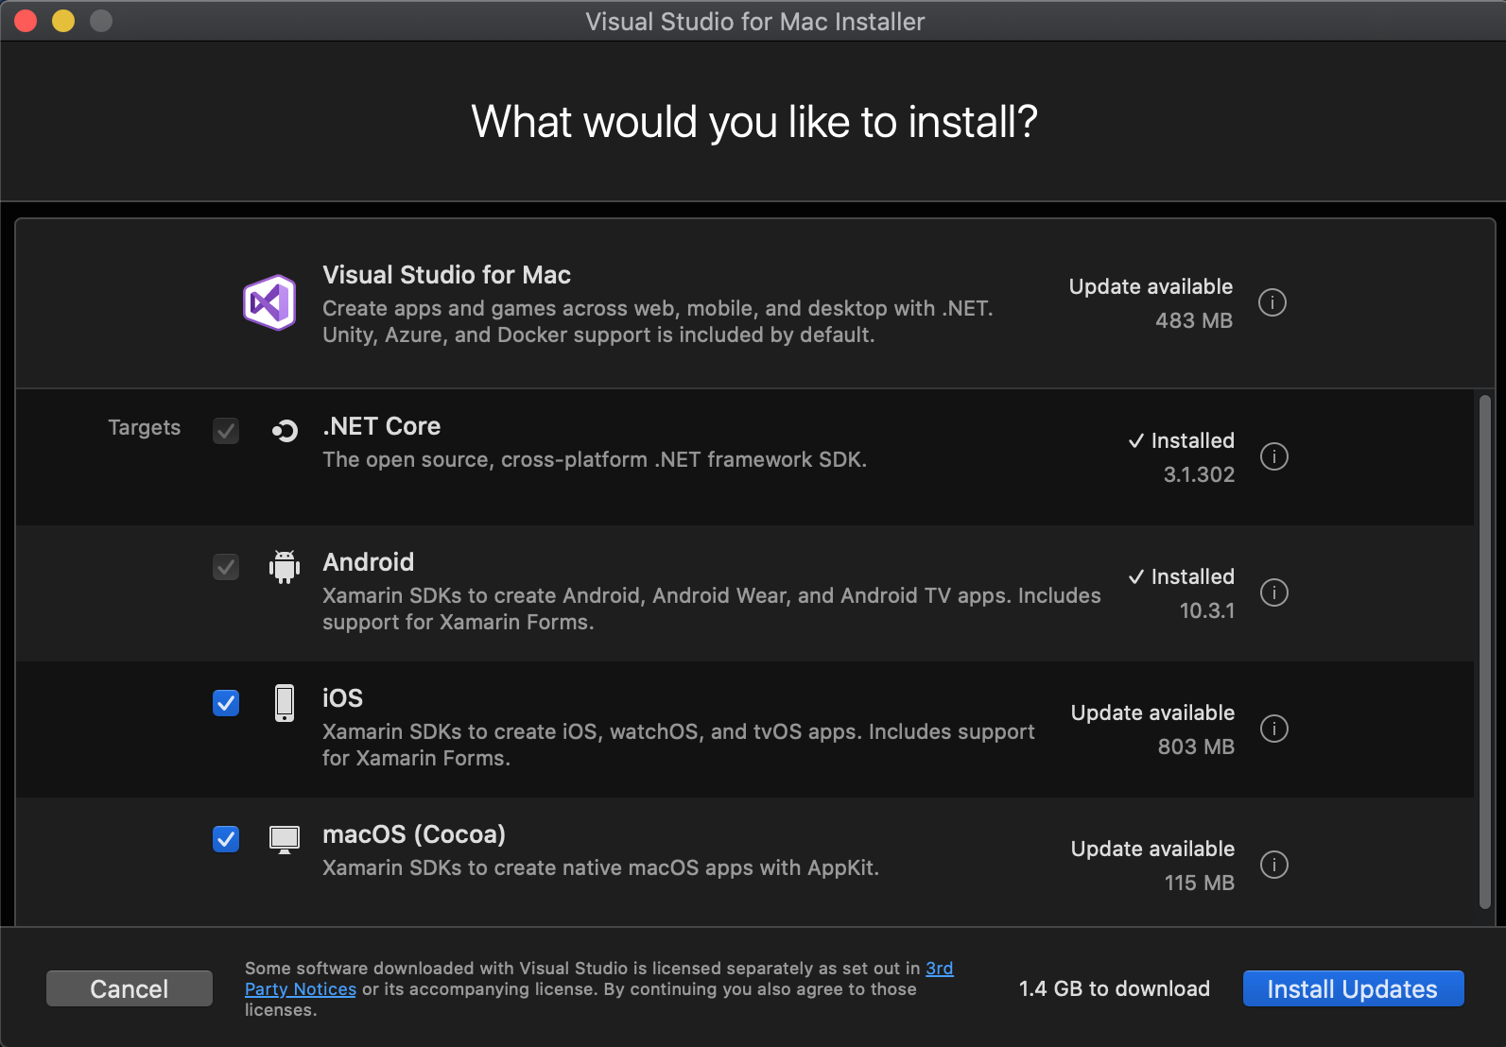
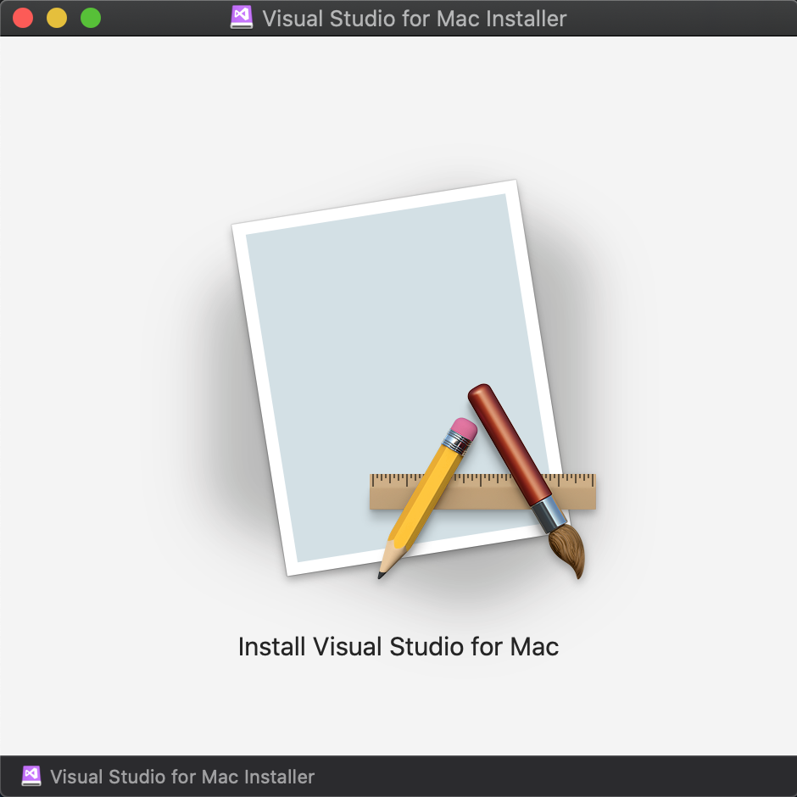
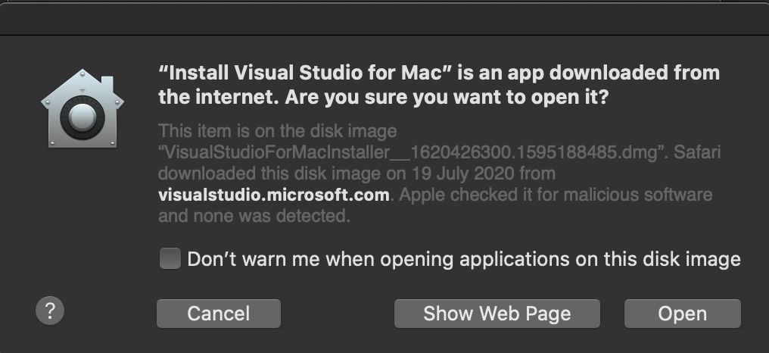
The new Visual Studio for Mac installer

Slide 5
The new Visual Studio for Mac installer
At a minimum you should install the Core VS for Mac and .NET Core models. This will grant you basic Windows Desktop DX / GL targets
Installing the additional modules will give you the following platforms:
Android
iOS phone and tablet
Mac desktop
Be sure to check the video below for best-practices in setting up a multi-platform MonoGame Project:
http://bit.ly/monogamemulti-platform

Slide 6
New for MonoGame 3.8 - .NET Core support
MonoGame 3.8 changes the way MonoGame is deployed.
New NuGet by default supported projects, no installer needed.
Templates are now deployed by Visual Studio Extension.
Command-Line Interface (CLI) options available.
MonoGame just got way cooler.

Slide 7
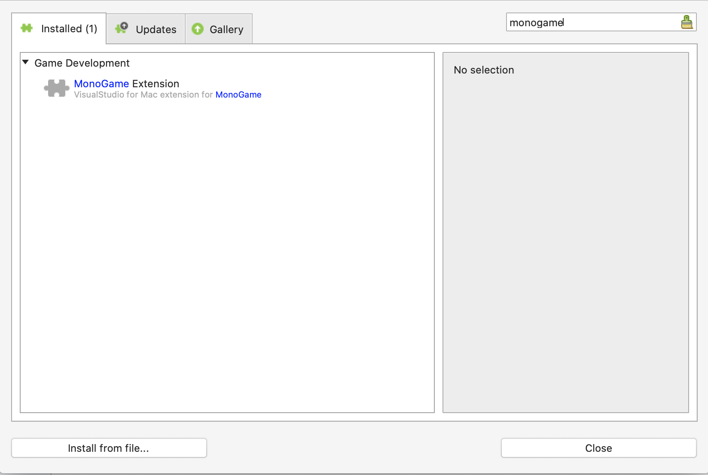
MonoGame project templates
Extensions installed from within Visual Studio for Mac
Open a new project (any) and select “Visual Studio -> Extensions” From the menu
Search for “MonoGame” in the Gallery
*Check the online documentation for installing “Development” builds https://docs.monogame.net/articles/getting_started/getting_started.html

Slide 8


MonoGame Content Builder Editor (MGCB)
Provided you have installed the .NETCore SDK https://dotnet.microsoft.com/download
Installing the MCGB-Editor is just two simple Terminal Commands
One to Install the tool and one to register it with VS for Mac

Slide 9
Building for Android
What is required for android development

Slide 10


Android setup for Visual Studio for Mac
Requires the Android module
This installs the latest Android SDK for target builds
Be aware it’s a fragmented platform – likely need several projects
No emulator support, so physically testing is critical due to device differences, plan ahead. Also use Visual App Center to build / test and deploy your game to multiple devices. https://appcenter.ms/

Slide 11
Building for iOS
What is required for Apple iPhone/iPad development

Slide 12


iOS setup for Visual Studio for Mac
Requires the iOS module
There is an iPhone simulator available with XCode, which you will need to install separately
Physically testing is critical due to device differences, plan ahead. Also use Visual App Center to build / test and deploy your game to multiple devices. https://appcenter.ms/

Slide 13
Building for MacOS
What is required for Apple desktop development

Slide 14

iOS setup for Visual Studio for Mac
Requires the macOS module
Test and build on your device
Don’t forget to get other testers on older hardware if you intend to support them

Slide 15
Other considerations

Slide 16
Other considerations building with MonoGame
Plan your content If targeting multiple platforms, try to use a single shared content project to reduce overhead Add additional “platform specific” content projects only when required
Market early It’s essential to build up good relations with each market store. Almost never too early to “get out in front”
Test often Some platforms will require more testing than others, plan to test deployment and not just gameplay. Use test tools where possible.

Slide 17
Thanks for watching
Darkside of Monogame
Simon Jackson
Author and Microsoft MVP
@SimonDarksidej

